Slide 1
Artificial Intelligence DR.Abeer Amer

Slide 2

Artificial Intelligence Search Agents

Slide 3
Goal-based agents
Reflex agents: use a mapping from states to actions.
Goal-based agents: problem solving agents or planning agents.

Slide 4
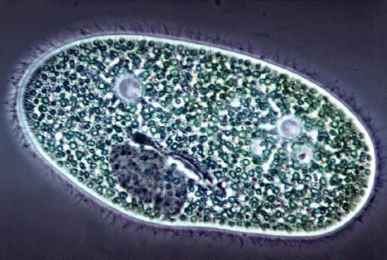
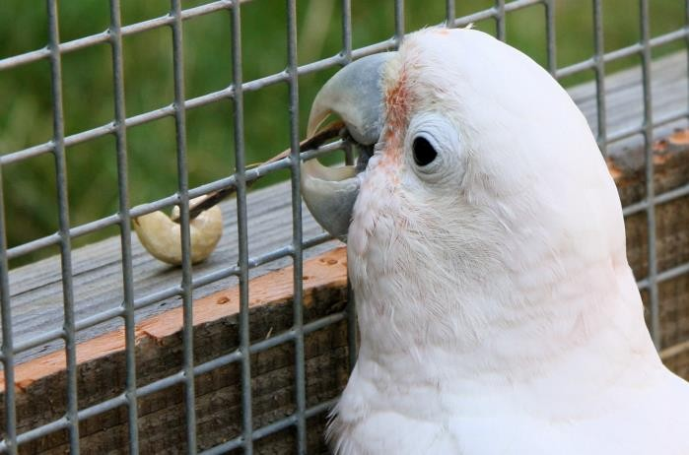
Types ofAgents
a Reflex Agent :
a Planning agent :
Considers how the world IS
Choose action based on current percept.
Do not consider the future consequences of actions.
Considers how the world WOULD BE
Decisions based on (hypothesized) consequences of actions.
Must have a model of how the world evolves in response to actions.
Must formulate a goal.
Source: D. Klein, P. Abbeel

Slide 5
State Space Search
Problems are solved by searching among alternative choices.
Humans consider several alternative strategies on their way
to solving a problem.
A Chess player considers a few alternative moves.
A mathematician chooses from a different strategies to
find a proof for a theorem.
A physician evaluates several possible diagnoses.

Slide 6
Example:Tic-Tac-Toe Game
X
 | X
 |  | X
X
 | X
 |  | X
 | X
 |  | X
X
O
 | X
 | O
 | X
 |  | O
 | X |  |  | O | X |  |  |  | X | O |  |  | X
 |  |  |  |  |  |  |  |  |  |  |  | O
 | X |  |  |  | X
 | O |  |  |  |  | O

Slide 7
How Human Beings Think ..?
Human beings do not search the entire state space (exhaustive search).
Only alternatives that experience has shown to be effective are explored.
Human problem solving is based on judgmental rules that limit the exploration of search space to those portions of state space that seem somehow promising.
These judgmental rules are known as “heuristics”.

Slide 8
Heuristic Search
A heuristic is a strategy for selectively exploring the search space.
It guides the search along lines that have a high probability of success.
It employs knowledge about the nature of a problem to find a solution.
It does not guarantee an optimal solution to the problem but can come close most of the time.
Human beings use many heuristics in problem solving.

Slide 9



Search
We will consider the problem of designing goal-based agents in fully observable, deterministic, discrete, known environments.
Start State
Goal State

Slide 10
Search
We will consider the problem of designing goal-based agents in fully observable, deterministic, discrete, known environments.
The agent must find a sequence of actions that reaches the goal. The performance measure is defined by:
reaching the goal, and ..
how “expensive” the path to the goal is.

Slide 11
Search Problem Components
Initial
Initial state Actions Transition model
What state results from performing a given action in each state?
Goal state Solution Path Path cost
Assume that it is a sum of
nonnegative step costs
State
Goal State
The optimal solution is the sequence of actions that gives the
lowest path cost for reaching the goal.

Slide 12
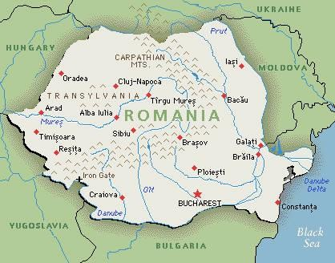
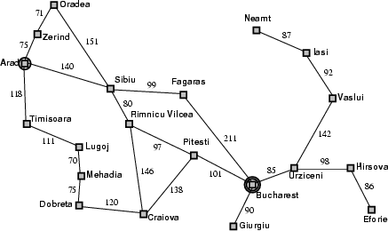
Example:Romania
On vacation in Romania; currently in Arad.
Flight leaves tomorrow from Bucharest.
Initial state
Arad
Actions
Go from one city to another
Transition Model
If you go from city A to
city B, you end up in city B
Goal State
Bucharest
Path Cost
Sum of edge costs (total distance traveled)

Slide 13
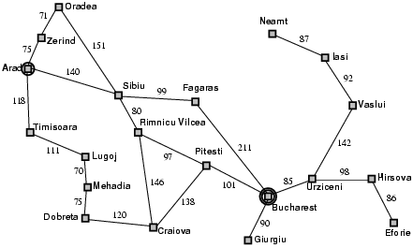
State Space
The initial state, actions, and transition model define the state
space of the problem;
The set of all states reachable from initial state by any sequence of actions.
Can be represented as a directed graph where the nodes are states and links between nodes are actions.
What is the state space for the Romania problem?

Slide 14
State Space
An AI problem can be represented as a state space graph.
A graph is a set of nodes and links that connect them. Graph theory:
Labeled graph.
Directed graph.
Path.
Rooted graph.
Tree.
Parent.
Child.
Sibling.
Ancestor.
Descendant.

Slide 15
Goal-based agents
Agents that work towards a goal.
Agents consider the impact of actions on future states.
Agent’s job is to identify the action or series of actions that lead to the goal.

Slide 16

Goal-based agents
Agents that work towards a goal.
Agents consider the impact of actions on future states.
Agent’s job is to identify the action or series of actions that lead to the goal.
Formalized as a search through possible solutions.

Slide 17

Examples

Slide 18
Examples
EXPLORE!

Slide 19
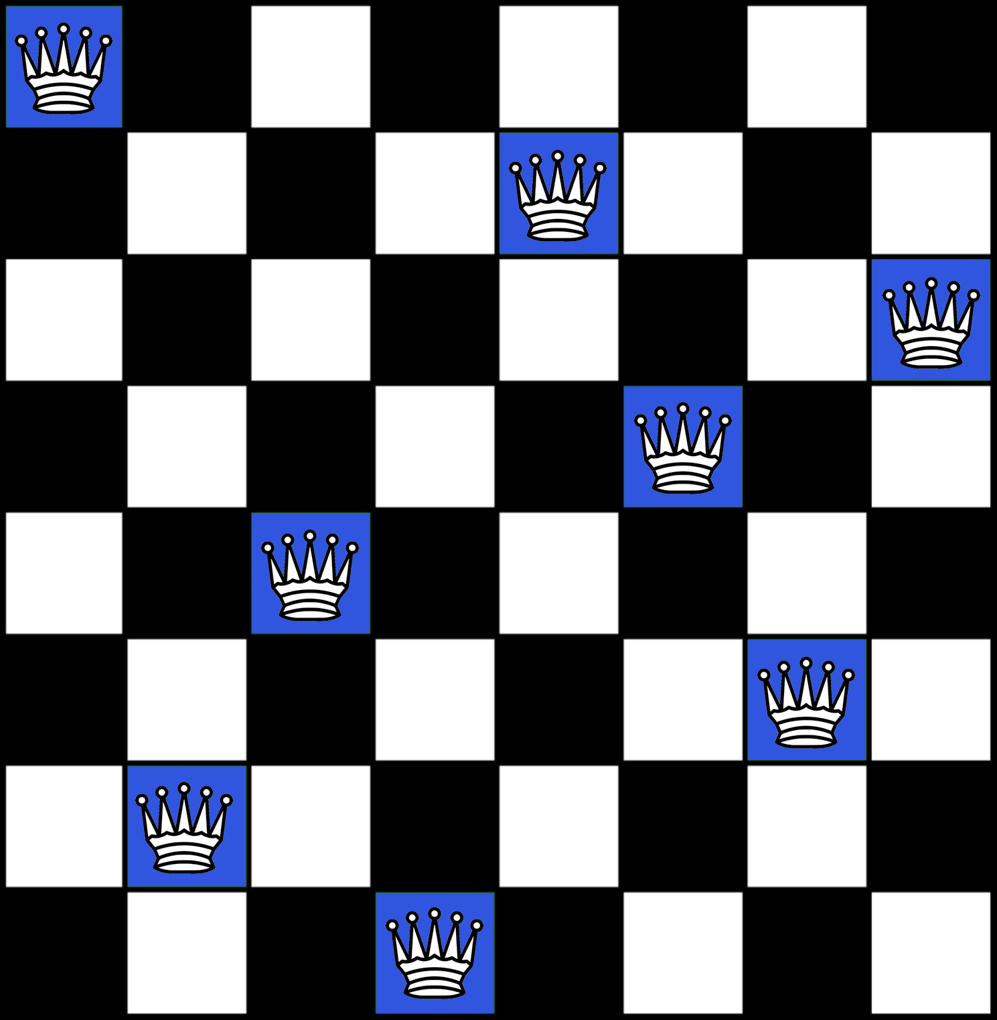
Examples
The 8-queen problem: on a chess board, place 8 queens so that no queen is attacking any other horizontally, vertically or diagonally.

Slide 20
Examples
Number of possible sequences to investigate:
64 ∗ 63 ∗ 62 ∗ ... ∗ 57 = 1.8 × 10¹⁴

Slide 21
Problem solving as search
Define the problem through:
Goal formulation
Problem formulation

Slide 22
Problem formulation
Initial state: the state in which the agent starts

Slide 23
Problem formulation
Initial state: the state in which the agent starts
States: All states reachable from the initial state by any se- quence of actions (State space)

Slide 24
Problem formulation
Initial state: the state in which the agent starts
States: All states reachable from the initial state by any se- quence of actions (State space)
Actions: possible actions available to the agent. At a state s, Actions(s) returns the set of actions that can be executed in state s. (Action space)

Slide 25
Problem formulation
Initial state: the state in which the agent starts
States: All states reachable from the initial state by any se- quence of actions (State space)
Actions: possible actions available to the agent. At a state s, Actions(s) returns the set of actions that can be executed in state s. (Action space)
Transition model: A description of what each action does
Results(s, a)

Slide 26
Problem formulation
Initial state: the state in which the agent starts
States: All states reachable from the initial state by any se- quence of actions (State space)
Actions: possible actions available to the agent. At a state s, Actions(s) returns the set of actions that can be executed in state s. (Action space)
Transition model: A description of what each action does
Results(s, a)
Goal test: determines if a given state is a goal state

Slide 27
Problem formulation
Initial state: the state in which the agent starts
States: All states reachable from the initial state by any se- quence of actions (State space)
Actions: possible actions available to the agent. At a state s, Actions(s) returns the set of actions that can be executed in state s. (Action space)
Transition model: A description of what each action does
Results(s, a)
Goal test: determines if a given state is a goal state
Path cost: function that assigns a numeric cost to a path
w.r.t. performance measure

Slide 28
Examples
States: all arrangements of 0 to 8 queens on the board.

Slide 29
Examples
States: all arrangements of 0 to 8 queens on the board.
Initial state: No queen on the board

Slide 30
Examples
States: all arrangements of 0 to 8 queens on the board.
Initial state: No queen on the board
Actions: Add a queen to any empty square

Slide 31
Examples
States: all arrangements of 0 to 8 queens on the board.
Initial state: No queen on the board
Actions: Add a queen to any empty square
Transition model: updated board

Slide 32
Examples
States: all arrangements of 0 to 8 queens on the board.
Initial state: No queen on the board
Actions: Add a queen to any empty square
Transition model: updated board
Goal test: 8 queens on the board with none attacked

Slide 33
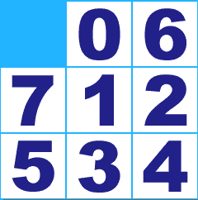
Examples
8 puzzles

Slide 34
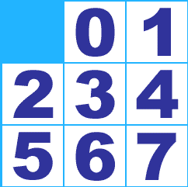

Examples

Slide 35
Examples
Start State
Goal State

Slide 36
Examples
States: Location of each of the 8 tiles in the 3x3 grid
Initial state: Any state
Actions: Move Left, Right, Up or Down
Transition model: Given a state and an action, returns re- sulting state
Goal test: state matches the goal state?
Path cost: total moves, each move costs 1.

Slide 37
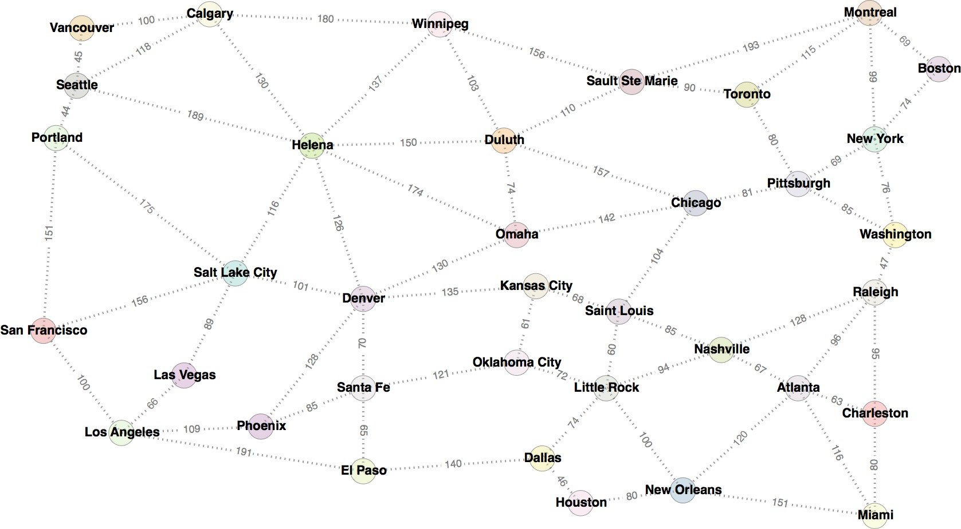
Examples of search agents

Slide 38
Examples
States: In City where
City ∈ {Los Angeles, San Francisco, Denver,...}
Initial state: In Boston
Actions: Go New York, etc.
Transition model:
Results (In (Boston), Go (New York)) = In(New York)
Goal test: In(Denver)
Path cost: path length in kilometers

Slide 39
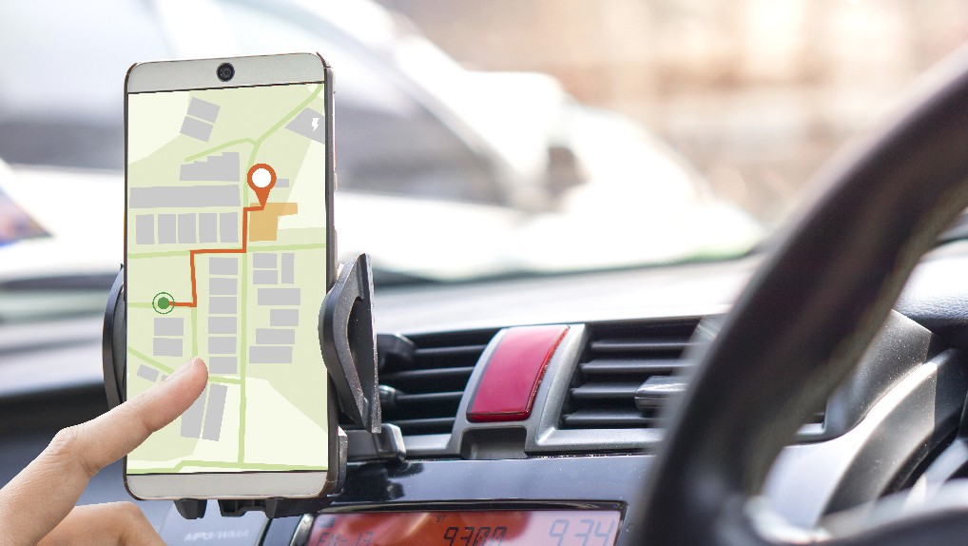
Real-world examples
Route finding problem: typically our example of map search, where we need to go from location to location using links or transitions. Example of applications include tools for driving directions in websites, in-car systems, etc.

Slide 40
State space vs. search space
State space: a physical configuration

Slide 41
State space vs. search space
State space: a physical configuration
Search space: an abstract configuration search tree or graph of possible solutions.
represented by a

Slide 42
State space vs. search space
State space: a physical configuration
Search space: an abstract configuration search tree or graph of possible solutions.
represented by a
Search tree: models the sequence of actions
Root: initial state
Branches: actions
Nodes: results from actions. A node has: parent, children, depth, path cost, associated state in the state space.

Slide 43
State space vs. search space
State space: a physical configuration
Search space: an abstract configuration search tree or graph of possible solutions.
represented by a
Search tree: models the sequence of actions
Root: initial state
Branches: actions
Nodes: results from actions. A node has: parent, children, depth, path cost, associated state in the state space.
Expand: A function that given a node, creates all children nodes

Slide 44
Search Space Regions
The search space is divided into three regions:
Explored (a.k.a. Closed List, Visited Set)
Frontier (a.k.a. Open List, the Fringe)
Unexplored.
The essence of search is moving nodes from regions (3) to (2) to (1), and the essence of search strategy is deciding the order of such moves.
In the following we adopt the following color coding: orange nodes are explored, grey nodes are the frontier, white nodes are unexplored, and black nodes are failures.

Slide 45
Examples of search agents
Let’s show the first steps in growing the search tree to find a route from San Francisco to another city

Slide 46
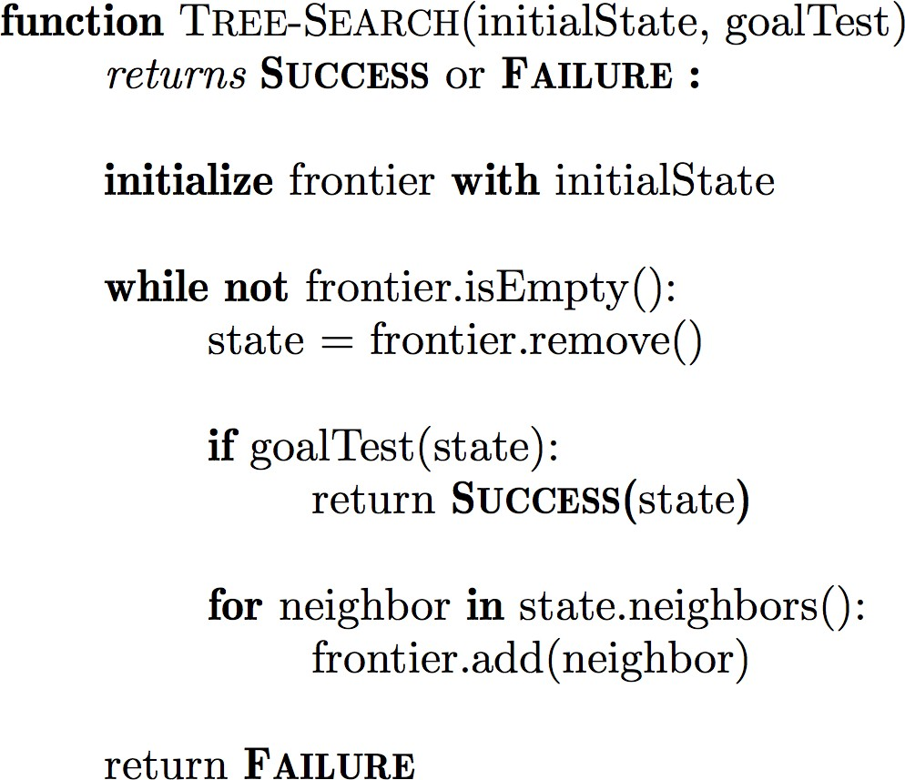
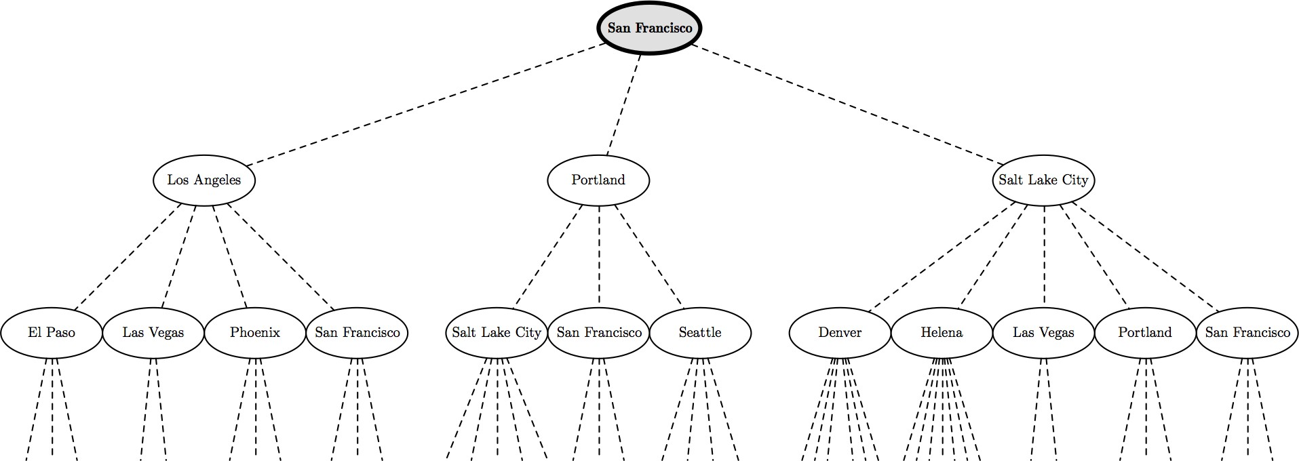
Examples of search agents

Slide 47
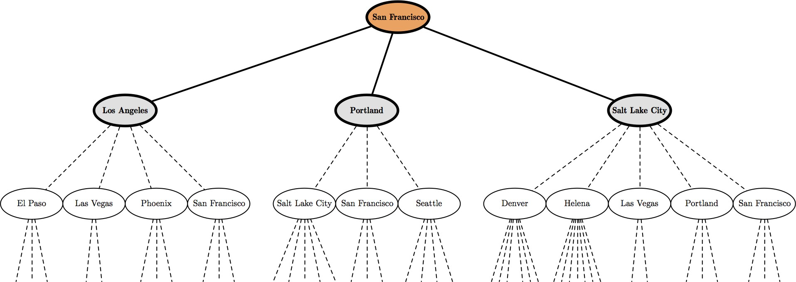
Examples of search agents

Slide 48
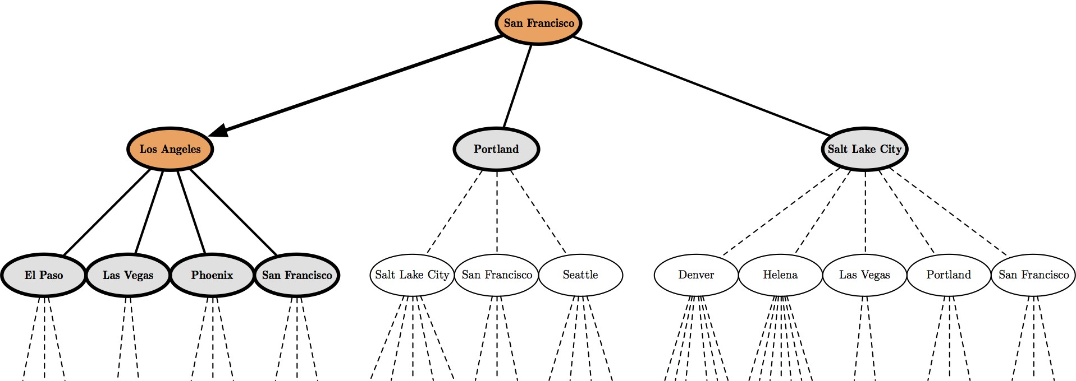
Examples of search agents

Slide 49
Credit
Artificial Intelligence, A Modern Approach. Stuart Russell and Peter Norvig. Third Edition. Pearson Education.
http://aima.cs.berkeley.edu/

